Slide 1
Neural Style Transfer
And what we can learn from it

Slide 2
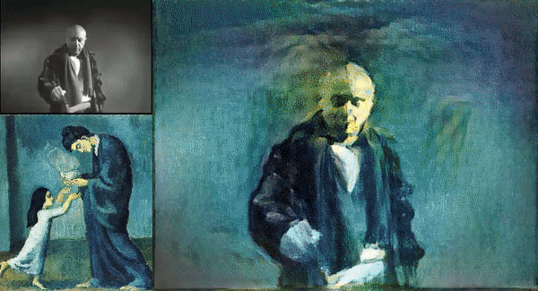
What is Neural Style Transfer?
medium.com/data-science-group-iitr/artistic-style-transfer-with-convolutional-neural-network-7ce2476039fd
Notes:
What is neural style transfer? This animation is a nice example. It shows Pablo Picasso, rendered in different styles that he had throughout his career

Slide 3
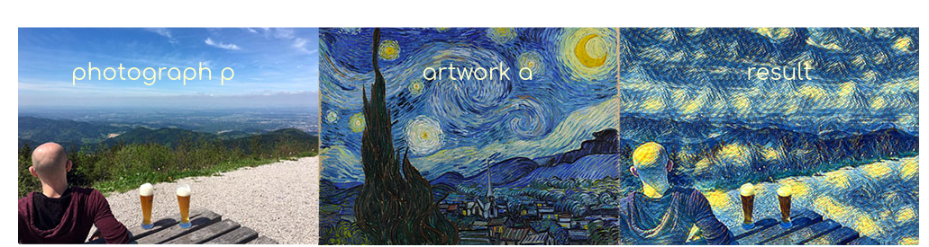
What is Neural Style Transfer?
Display content of p in style of a
https://www.pyimagesearch.com/2018/08/27/neural-style-transfer-with-opencv/
Notes:
So to summarize the question of what is NST: We want to display the content….
Of course this can be extended to other things than photographs and art, but for most of this talk, we will stick to this very setting

Slide 4
What is it good for?
Art and design
Sheds a light on the processes inside of neural networks
Maybe even helps understanding perception
Also: it is a great inspiration:
Rather than being some magical black box, neural networks are much more something we can manipulate, experiment with and are a great canvas for creative ideas
Notes:
For some motivation, on why we should care: What is NST good for?
It not justs looks nice, it can be a useful tool for artists and designers
… we will have a look at some other applications later on

Slide 5
How?
What is the content and what is the style of an image?
Content = edges?
Style = textures?
Or is it more complicated?
How does a Neural Network represent content and style?
Or more specifically: Where does a Neural Network represent content and style?
It turns out that in we can separate the representations quite well
Notes:
Now, that we know what NST is and have some motivation, let’s have a look at the intuition behind it.
First, how can we define content and style

Slide 6
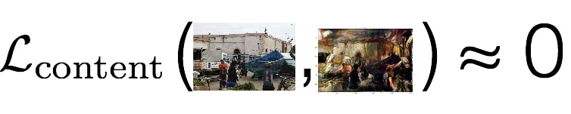

How?
Notes:
If we can extract content of an image, we can compare how similar two images are in respect to just their content.
Same is true for style.
This allows us, to define some loss term for each which we can minimize
So for a nice stylized image, we want the two losses to approach 0

Slide 7
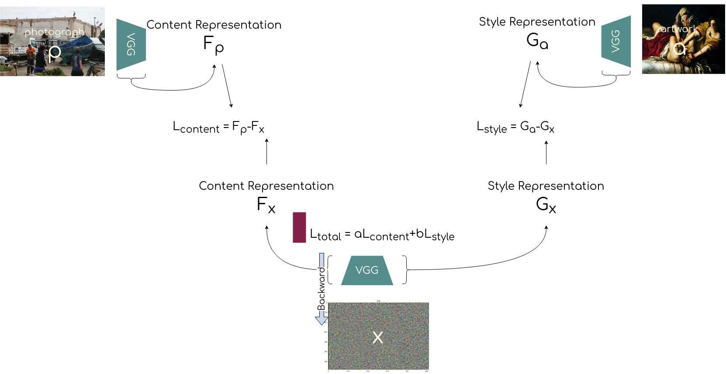
Notes:
Here is an overview of the setup, we will use
In the top left:...
Before we will go over the steps of the algorithm, we will take at look at this VGG thing here

Slide 8

neurohive.io/en/popular-networks/vgg16/

Slide 9
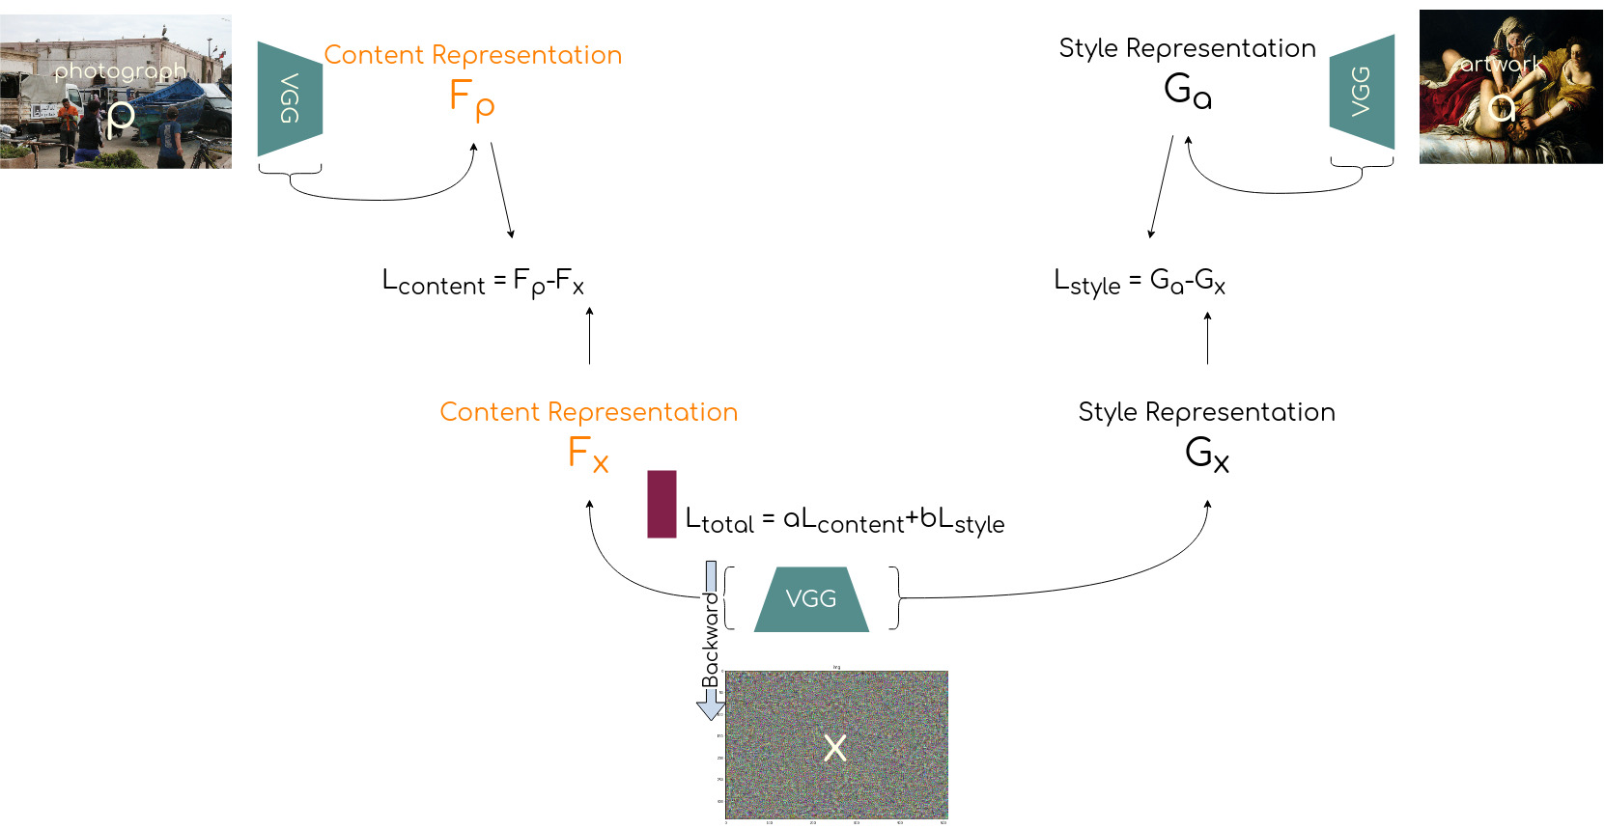
Get content representation of content image and input image

Slide 10
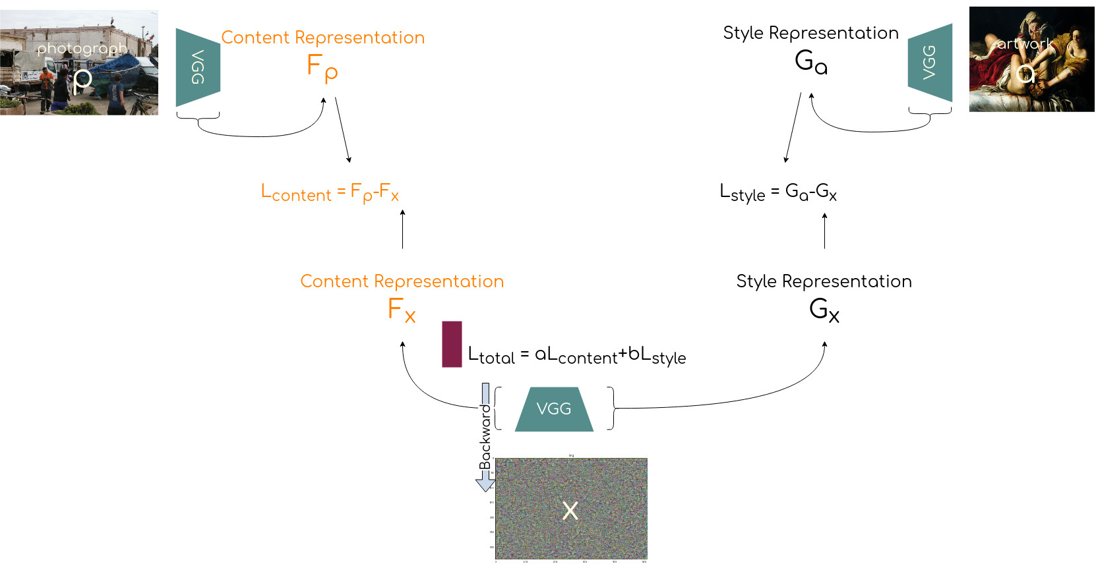
Get content loss

Slide 11
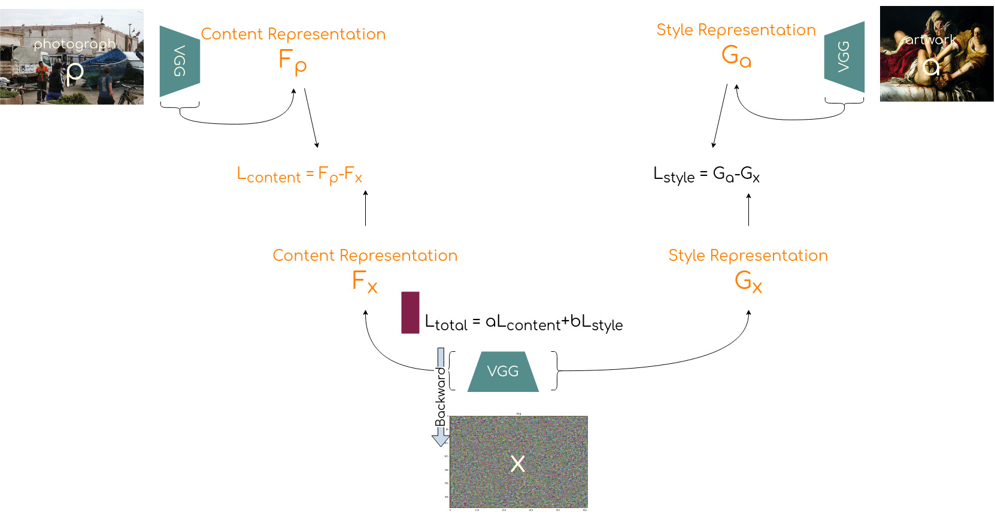
Get style of style image and input image

Slide 12
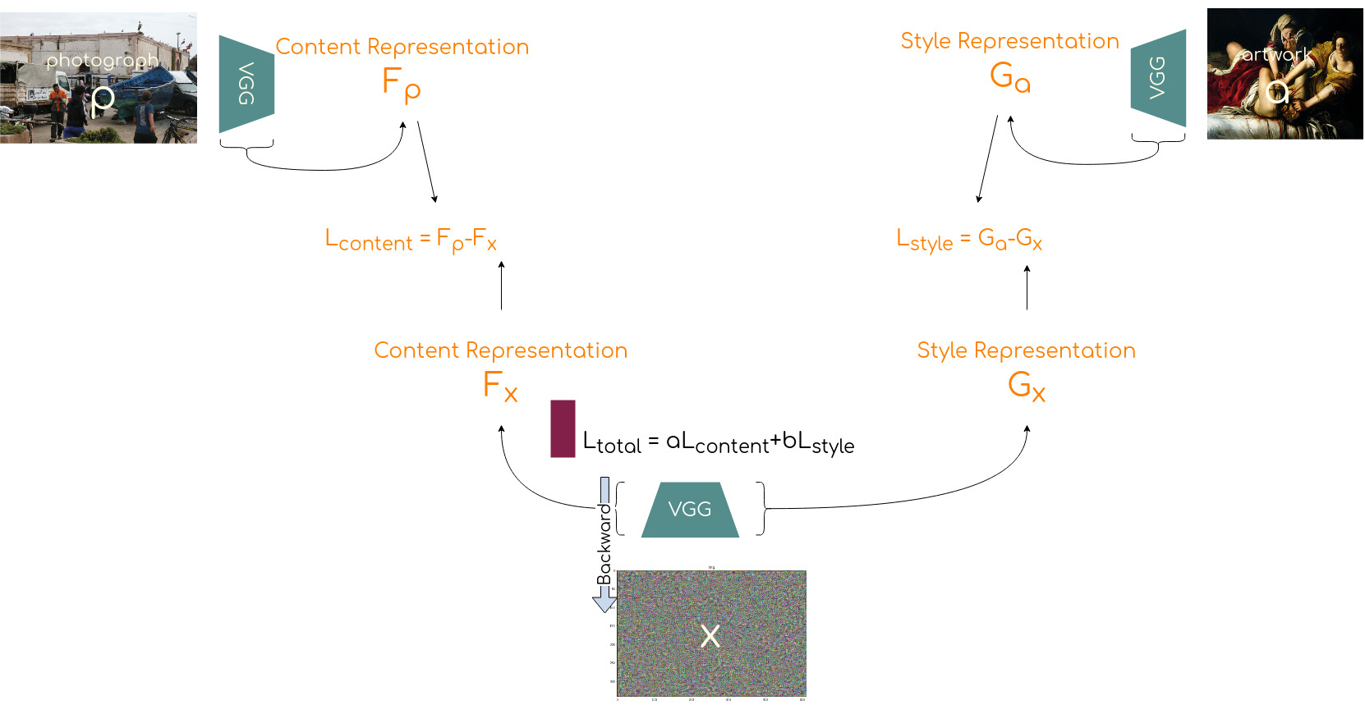
Get style loss

Slide 13
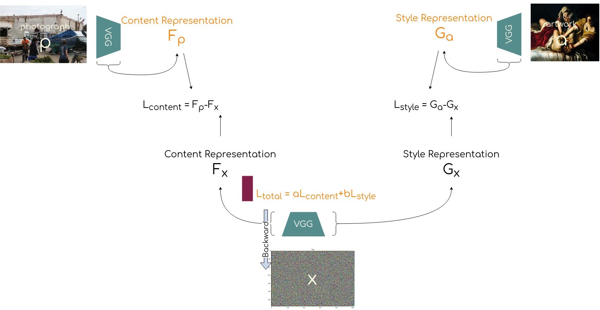
Calculate total loss

Slide 14
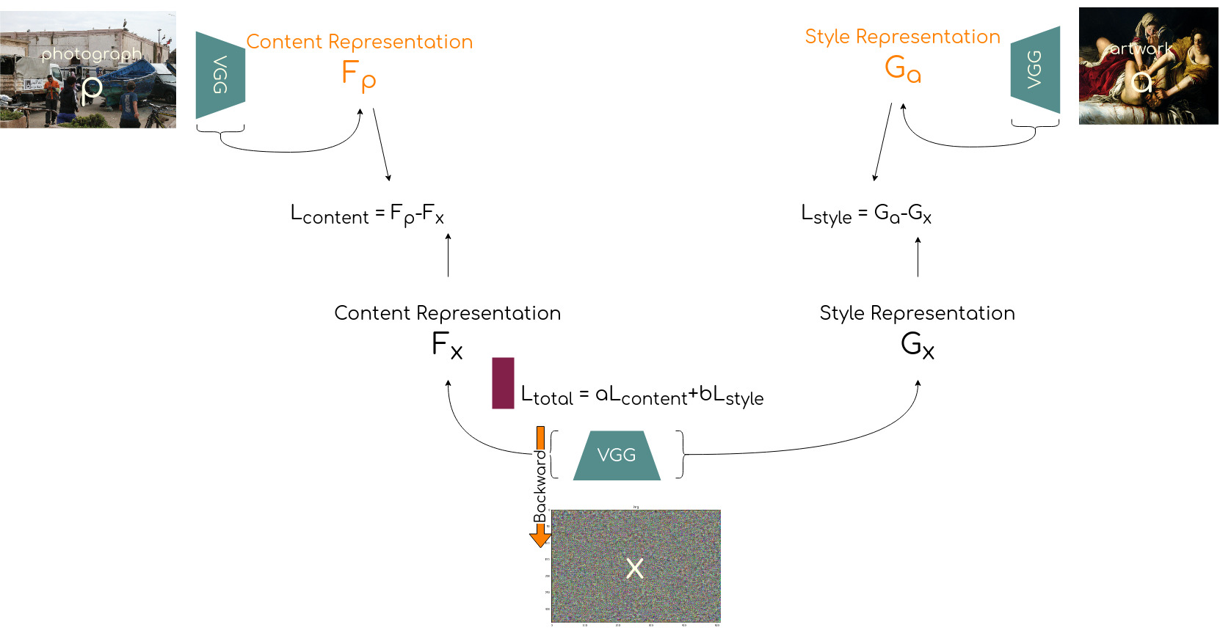
Backpropagate loss to input image

Slide 15
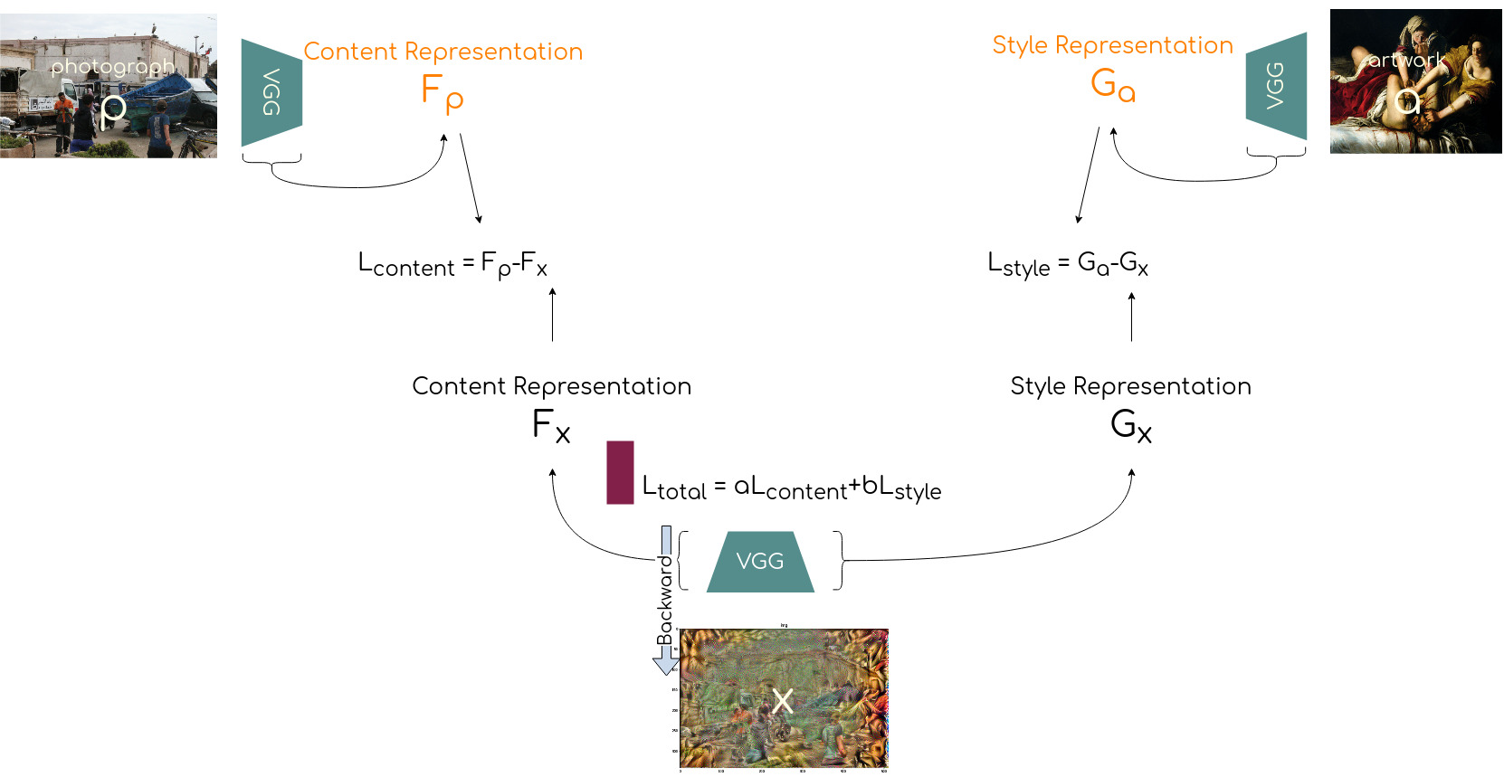
Adjust input image according to gradients

Slide 16
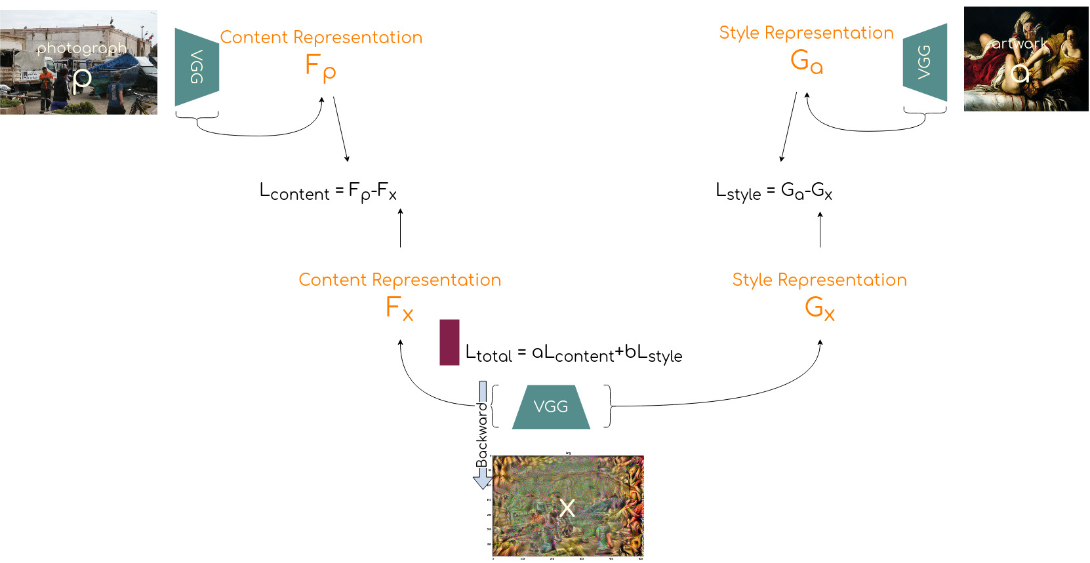
Get content and style representations of content image, style image and input image

Slide 17

Get content and style loss

Slide 18

Calculate total loss

Slide 19

Backpropagate loss to input image

Slide 20
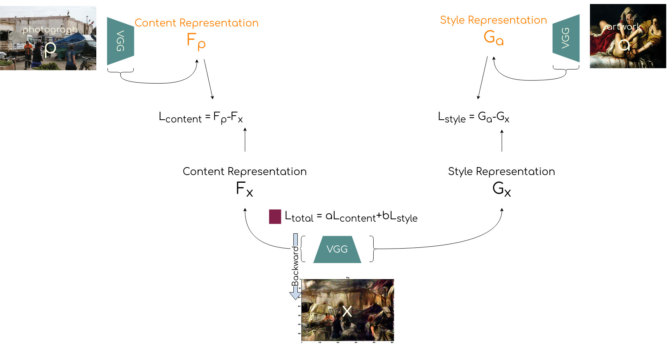
Adjust input image according to gradients

Slide 21
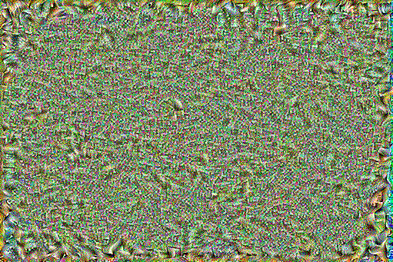
How?

Slide 22
How? - Content Representation
Representation of content
Output from conv layer are feature maps
feature map contains the position the activation of each filter
Feature matrix F of layer l contains
Each filter as row
And position as column
This way all features from layer l can be represented in nxm matrix with n=number of filter/features and m=height*width of feature map
Notes:
The output from a convolution layer are feature maps, that indicate, where each filter was activated by the previous layer (or input image)
The content representation of a given layer is a feature matrix

Slide 23
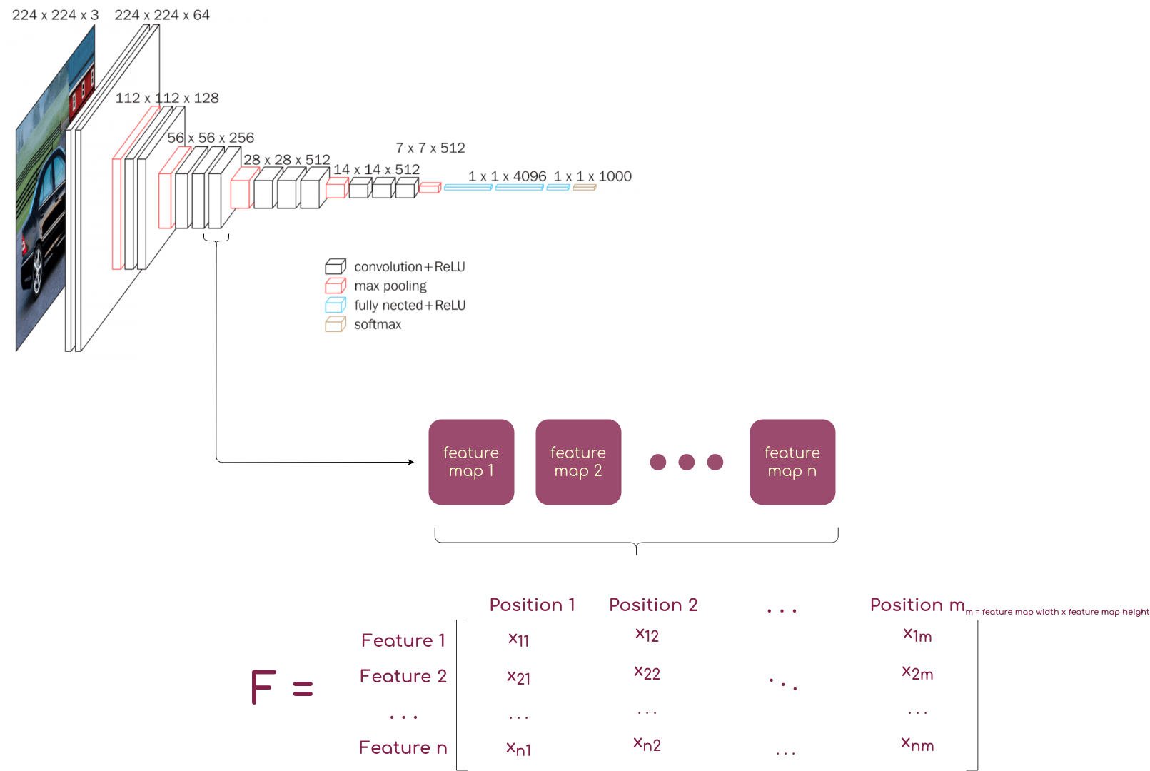
How? - Content Representation
https://neurohive.io/en/popular-networks/vgg16/

Slide 24
How? - Style Representation
How can we represent style?
Gram matrix contains inner product of all combinations of a set of vectors
For NST: set of vectors is set of vectorized feature maps
Not only of single layer, but of set of layers
Captures how often features co-occur
Which can be interpreted as spatially invariant representation of style
Notes:
I’ll admit that this is a little bit more elaborate
First, we need to know what a gram matrix is
We don’t care about where a brush stroke is in the image, but only about how it looks

Slide 25
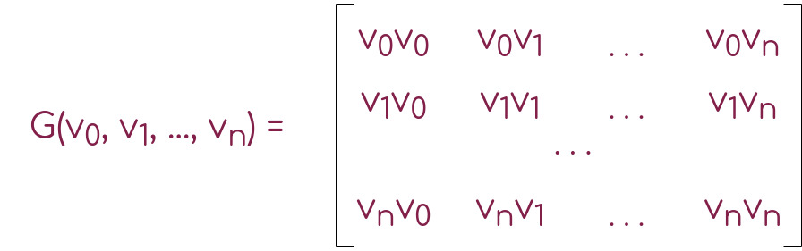
How? - Style Representation
How can we represent style?
Gram matrix contains inner product of all combinations of a set of vectors
For NST: set of vectors is set of vectorized feature maps
Not only of single layer, but of set of layers
Captures how often features co-occur
Which can be interpreted as spatially invariant representation of style
Notes:
I’ll admit that this is a little bit more elaborate
First, we need to know what a gram matrix is
We don’t care about where a brush stroke is in the image, but only about how it looks

Slide 26
How? - Style Representation
How can we represent style?
Gram matrix contains inner product of all combinations of a set of vectors
For NST: set of vectors is set of vectorized feature maps
Captures how often features co-occur
Which can be interpreted as spatially invariant representation of style
Notes:
I’ll admit that this is a little bit more elaborate
First, we need to know what a gram matrix is
We don’t care about where a brush stroke is in the image, but only about how it looks

Slide 27
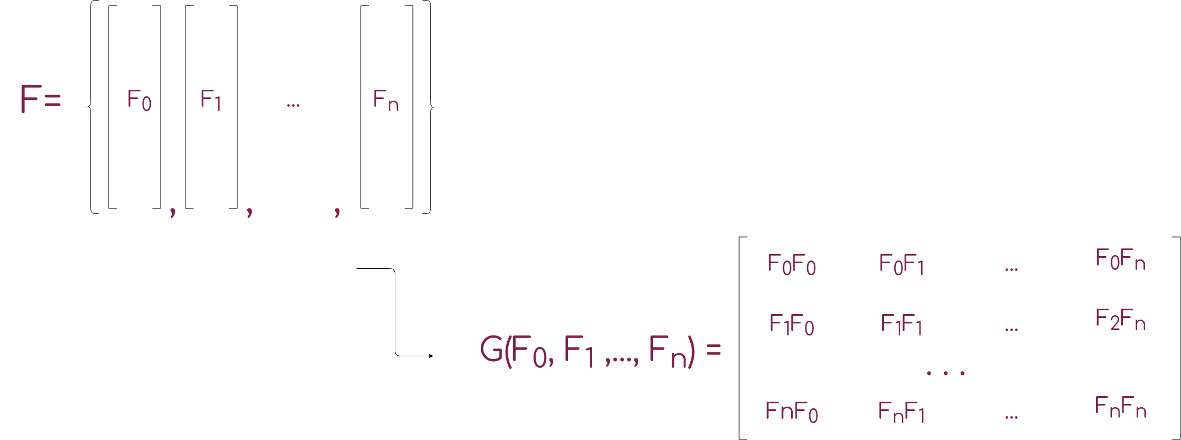
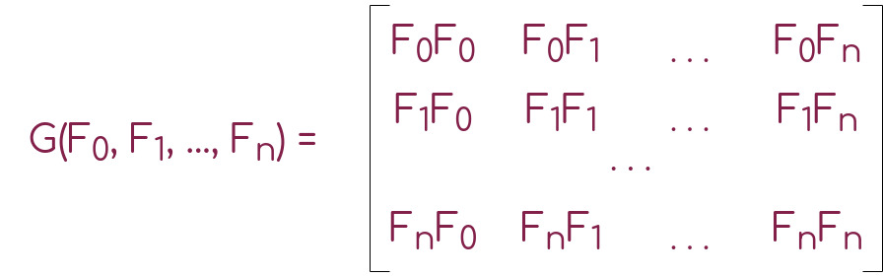
How? - Style Representation
Notes:
Feature maps contain information about position of feature, this gets destroyed by calculating the inner product -> spatially invariant
What remains is: This feature co-occurs with that feature, (that brush stroke, with that color)
Unfortunately, the gram matrix is not really visualizable and somewhat hard to grasp, so here I tried to visualize what happens if just the style of an image is applied to a noise image

Slide 28
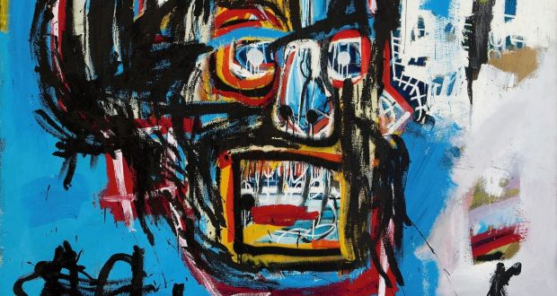
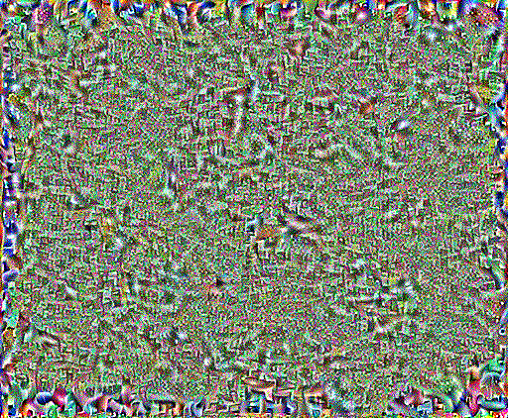
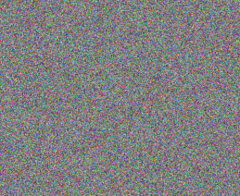
How? - Style Representation
Apply style

Slide 29
Choice of layers
Output is sensitive to what layers are chosen for style and content representation
Gatys et al. propose using layer 1-5 of VGG-Net for style representation and Layer 4 for content representation
For style: using multiple layers produces visually more appealing results
For content: using lower layers would preserve undesired fine structures while by using higher layers, fine structures from style image are used
Notes:
Fine structures like edges and color map

Slide 30
NST Algorithms
Image based
Iteratively optimize image to match content and style of examples
Require a lot of backward passes
Model based
Optimize a generative model to produce an image that matches content and style of examples
Addresses performance issues of Image based approaches
Require only one forward pass, after training
Notes:
Until now, i mostly focused on the original formulation by Gatys et al.
By now, there exist several other implementation, improvements and derivations
The field has become vast in a couple of years, therefore I will only present a few examples
generally , we can divide the field into two sub-categories

Slide 31
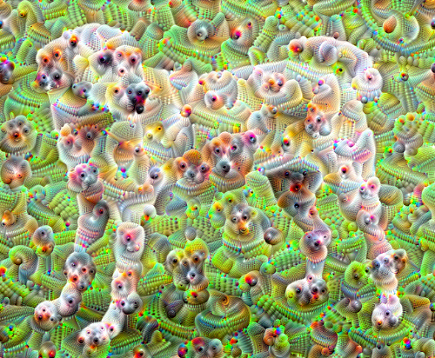
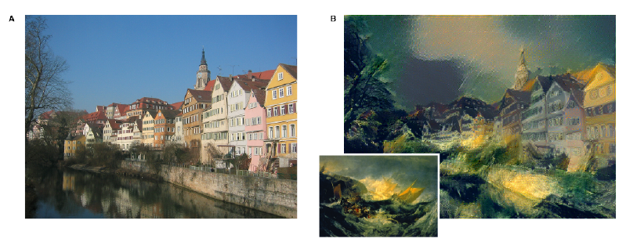
NST Algorithms - Image Based
Deep Dream
Optimize input image to maximally activate subsets of model
Original NST formulation
tensorflow.org/tutorials/generative/deepdream
Gatys et al. 2016
Notes:
Risser et al. introduced histogram loss, to make it more stable because the original implementation was somewhat hit or miss and often produced noisy stylized images
I should mention, there a lots of other approaches to image base NST algos

Slide 32
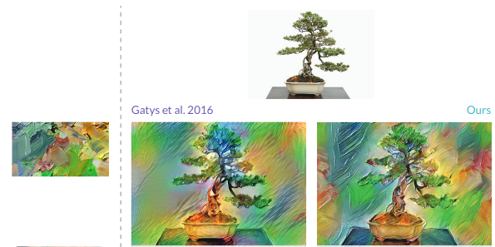
NST Algorithms - Image Based
Risser et al.
Feature activations with different means and variances can still have same Gram matrix
Punish unequal feature activation distributions with additional Histogram loss
Risser et al. 2017

Slide 33
NST Algorithms - Model Based
Single-style-per-model
Train style-specific model and then produce stylized image using single forward pass (-> real time, but new network for each style)
Multiple-style-per-model
Try to tie only a subset of parameters in a network to each style
Arbitrary-style-per-model
Extract subsets of features from representation of content image
Find most similar features in representation of style image
Swap them
Notes:
1.Most straight forward
This can be trained for example, by using images from an image based approach as data
2.Pre-defined set of styles
3. Most difficult… closest to image based approaches
Whitening transformation -> linear transformation
a coloring transformation transforms a vector of white random variables into a random vector with a specified covariance matrix.[2]

Slide 34
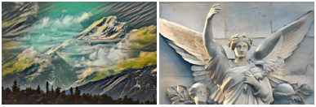
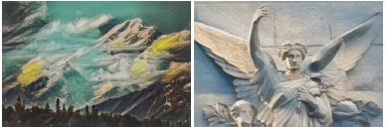
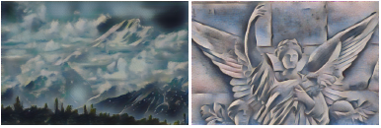
NST Algorithms - Model Based
Jing et al. 2018
Single-style-per-model
(Johnson et al. 2016)
Multiple-style-per-model
(Dumoulin et al. 2016)
Arbitrary-style-per-model
(Chen and Schmidt 2016)
Notes:
1.Most straight forward
This can be trained for example, by using images from an image based approach as data
2.Pre-defined set of styles
3. Most difficult… closest to image based approaches
Whitening transformation -> linear transformation
a coloring transformation transforms a vector of white random variables into a random vector with a specified covariance matrix.[2]

Slide 35
Applications
Social Media
Filters
User-assisted Creation tools
Help designers integrate a certain style into their work
Entertainment
Apply stylized rendering to animated sequences in movies or video games
Notes:
Where are those NST models actually used?

Slide 36
Challenges
Evaluation
Agreed upon evaluation methods may help us understand the underlying principles of what is perceived as aesthetically pleasing
Interpretability
Disentangled representations may help make NST more interpretable, controllable and applicable
Adversarial Attacks
NST could not only be attacked but used for creating adversarial examples
Notes:
The field of NST has progressed a lot, but there are still a lot of open challenges
One key challenge is how we can objectively evaluate different methods
Then there is the issue of Interpretability … one possible solution for this would be using disentangled representations
e.g. control brush size, texture type,... maybe even encode style of different artists as separate dimensions…
nns seem to favor texture information for decision making

Slide 37
Conclusion
Neural networks can be more than model.fit(X, y)
A good, intuitive understanding of their inner workings can help to create interesting and useful applications
Good representations are useful for downstream tasks

Slide 38
References
Gatys, L.A., Ecker, A.S. and Bethge, M., 2015. A neural algorithm of artistic style. arXiv preprint arXiv:1508.06576.
medium.com/data-science-group-iitr/artistic-style-transfer-with-convolutional-neural-network-7ce2476039fd
Simonyan, K. and Zisserman, A., 2014. Very deep convolutional networks for large-scale image recognition. arXiv preprint arXiv:1409.1556.
Mordvintsev, et al., "Differentiable Image Parameterizations", Distill, 2018.
Jing, Y., Yang, Y., Feng, Z., Ye, J., Yu, Y. and Song, M., 2019. Neural style transfer: A review. IEEE transactions on visualization and computer graphics.
Locatello, F., Bauer, S., Lucic, M., Rätsch, G., Gelly, S., Schölkopf, B. and Bachem, O., 2018. Challenging common assumptions in the unsupervised learning of disentangled representations. arXiv preprint arXiv:1811.12359.
Li, Y., Wang, N., Liu, J. and Hou, X., 2017. Demystifying neural style transfer. arXiv preprint arXiv:1701.01036.

Slide 39
Backup Slides
What is the training process?
The VGG net used needs to be pre trained in order to produce meaningful features
This can be done by training the net for a classification task for example
The rest of the training is just minimizing the two losses

Slide 40
Backup Slides
Can a Vision model different than VGG net be used?
Yes, but results are best with VGG model
Hypotheses:
VGG is very big and captures a lot of information that other model discard
VGG do not downsample aggressively, thus preserving features from input
Models like Resnet have mix different levels of abstraction in one layer, which makes it harder to make out features
These are however, hypotheses and have yet to be proved (which would probably help us expand our understanding of convolutional neural nets)

Slide 41
Backup Slides
Why does Gram matrix capture correlation of features?
It sums up feature vectors values at each position
So if features occur at same positions often, it will have a high value
Why do the correlations of features capture style?
In the Gram matrix, the spatial information is removed while information about features is kept

Slide 42
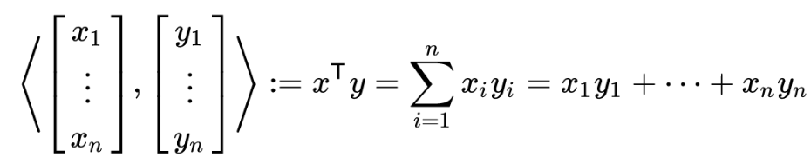
Backup Slides
Inner Product

Slide 43
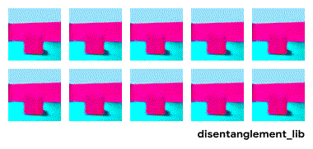
Backup Slides
What is disentanglement?
Represent independent generative factors of data as separate dimensions
https://github.com/google-research/disentanglement_lib

Slide 44

Backup Slides

